Slide 1
Take-home Kete Innovating strategy to innovate our organisations
Kia Whiti Tonu
To Shine Brightly

Slide 2
Resources
https://www.tetaumatatoiaiwi.org.nz/the-future-emerging-innovation-in-arts-and-culture-in-aotearoa/
Zaid Hassan – The Social Labs Revolution https://www.youtube.com/watch?v=f3Siqovj-RY
Hilary Cottom -Radical Help https://www.youtube.com/watch?v=tV49vVMPsYo
https://hbr.org/2019/07/how-to-do-strategic-planning-like-a-futurist
Donella Meadows http://donellameadows.org/archives/leverage-points-places-to-intervene-in-a-system/
https://www.dave-wild.com/
https://reospartners.com/

Slide 3
Feedback from workshop attendees

Slide 4
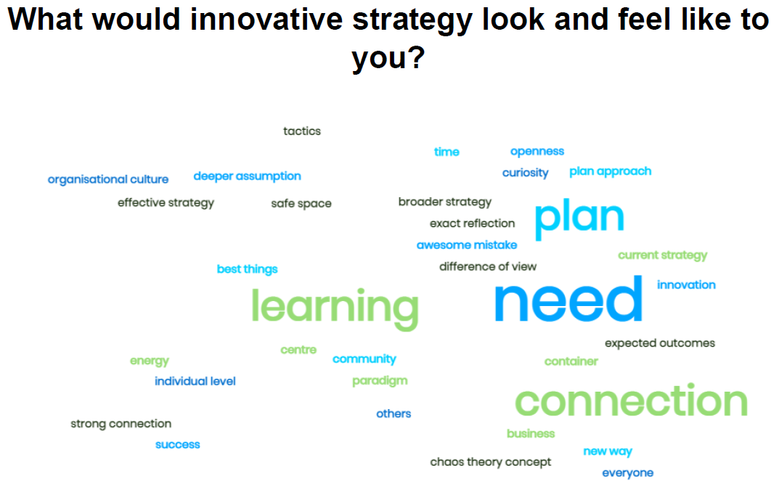
Feedback from workshop attendees

