Slide 1
Matariki
Kua haehae ngā hihi o Matariki (The rays of Matariki are spread)

Slide 2
Karakia tīmatanga
Hauora mai runga
Hauora mai raro
Hauora mai roto
Hauora mai waho
Hauora te pūtake o tēnei kaupapa
Kia pūrangiaho mātou, i te wānanga me te kōrero
Tenei te titi ake i te pou hauora ki te pūtake o tēnei wānanga
Tuturu o whiti whakamaua, kia tina, tina, haumie, hui e taiki e

Slide 3
Ko āu

Slide 4
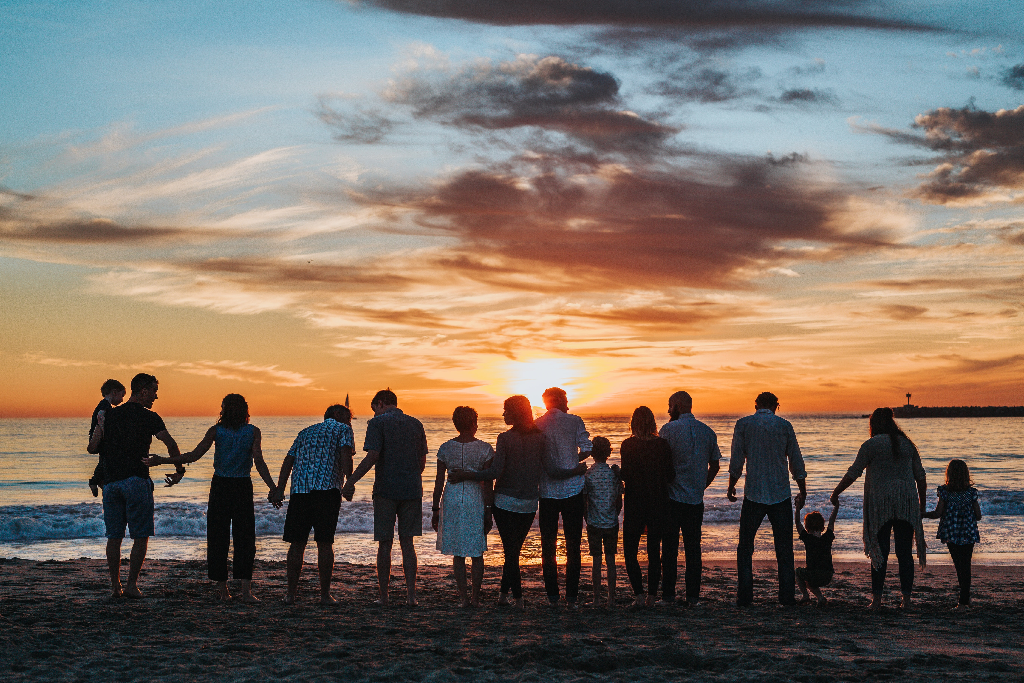
Nau mai
What brought you here?
Whakawhānauatanga

Slide 5
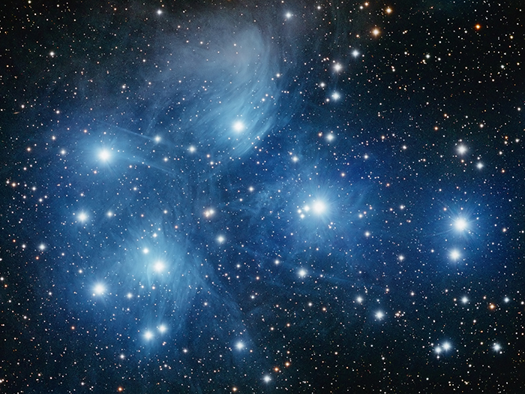
Kua haehae ngā hihi o Matariki
The Rays of Matariki are spread
He māramatanga tō tēnei whetū, he māramatanga anō tō tērā whetū.
Each star has its own light or presence in the sky.
Everyone is their own person.

Slide 6
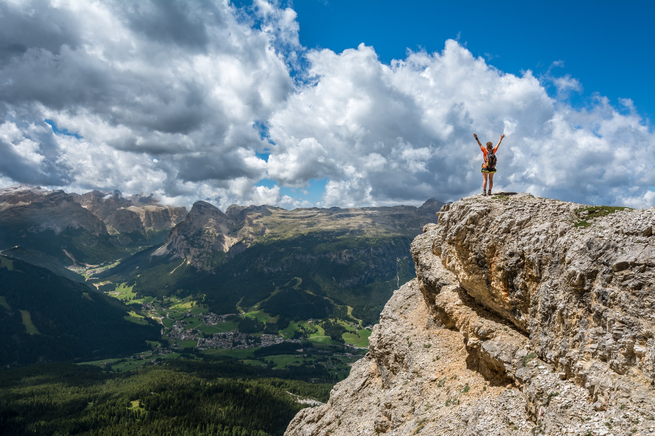
Reflection
Growth
Achievement
Breakout room question:
How did we grow?
What goals did we achieve or not?

Slide 7
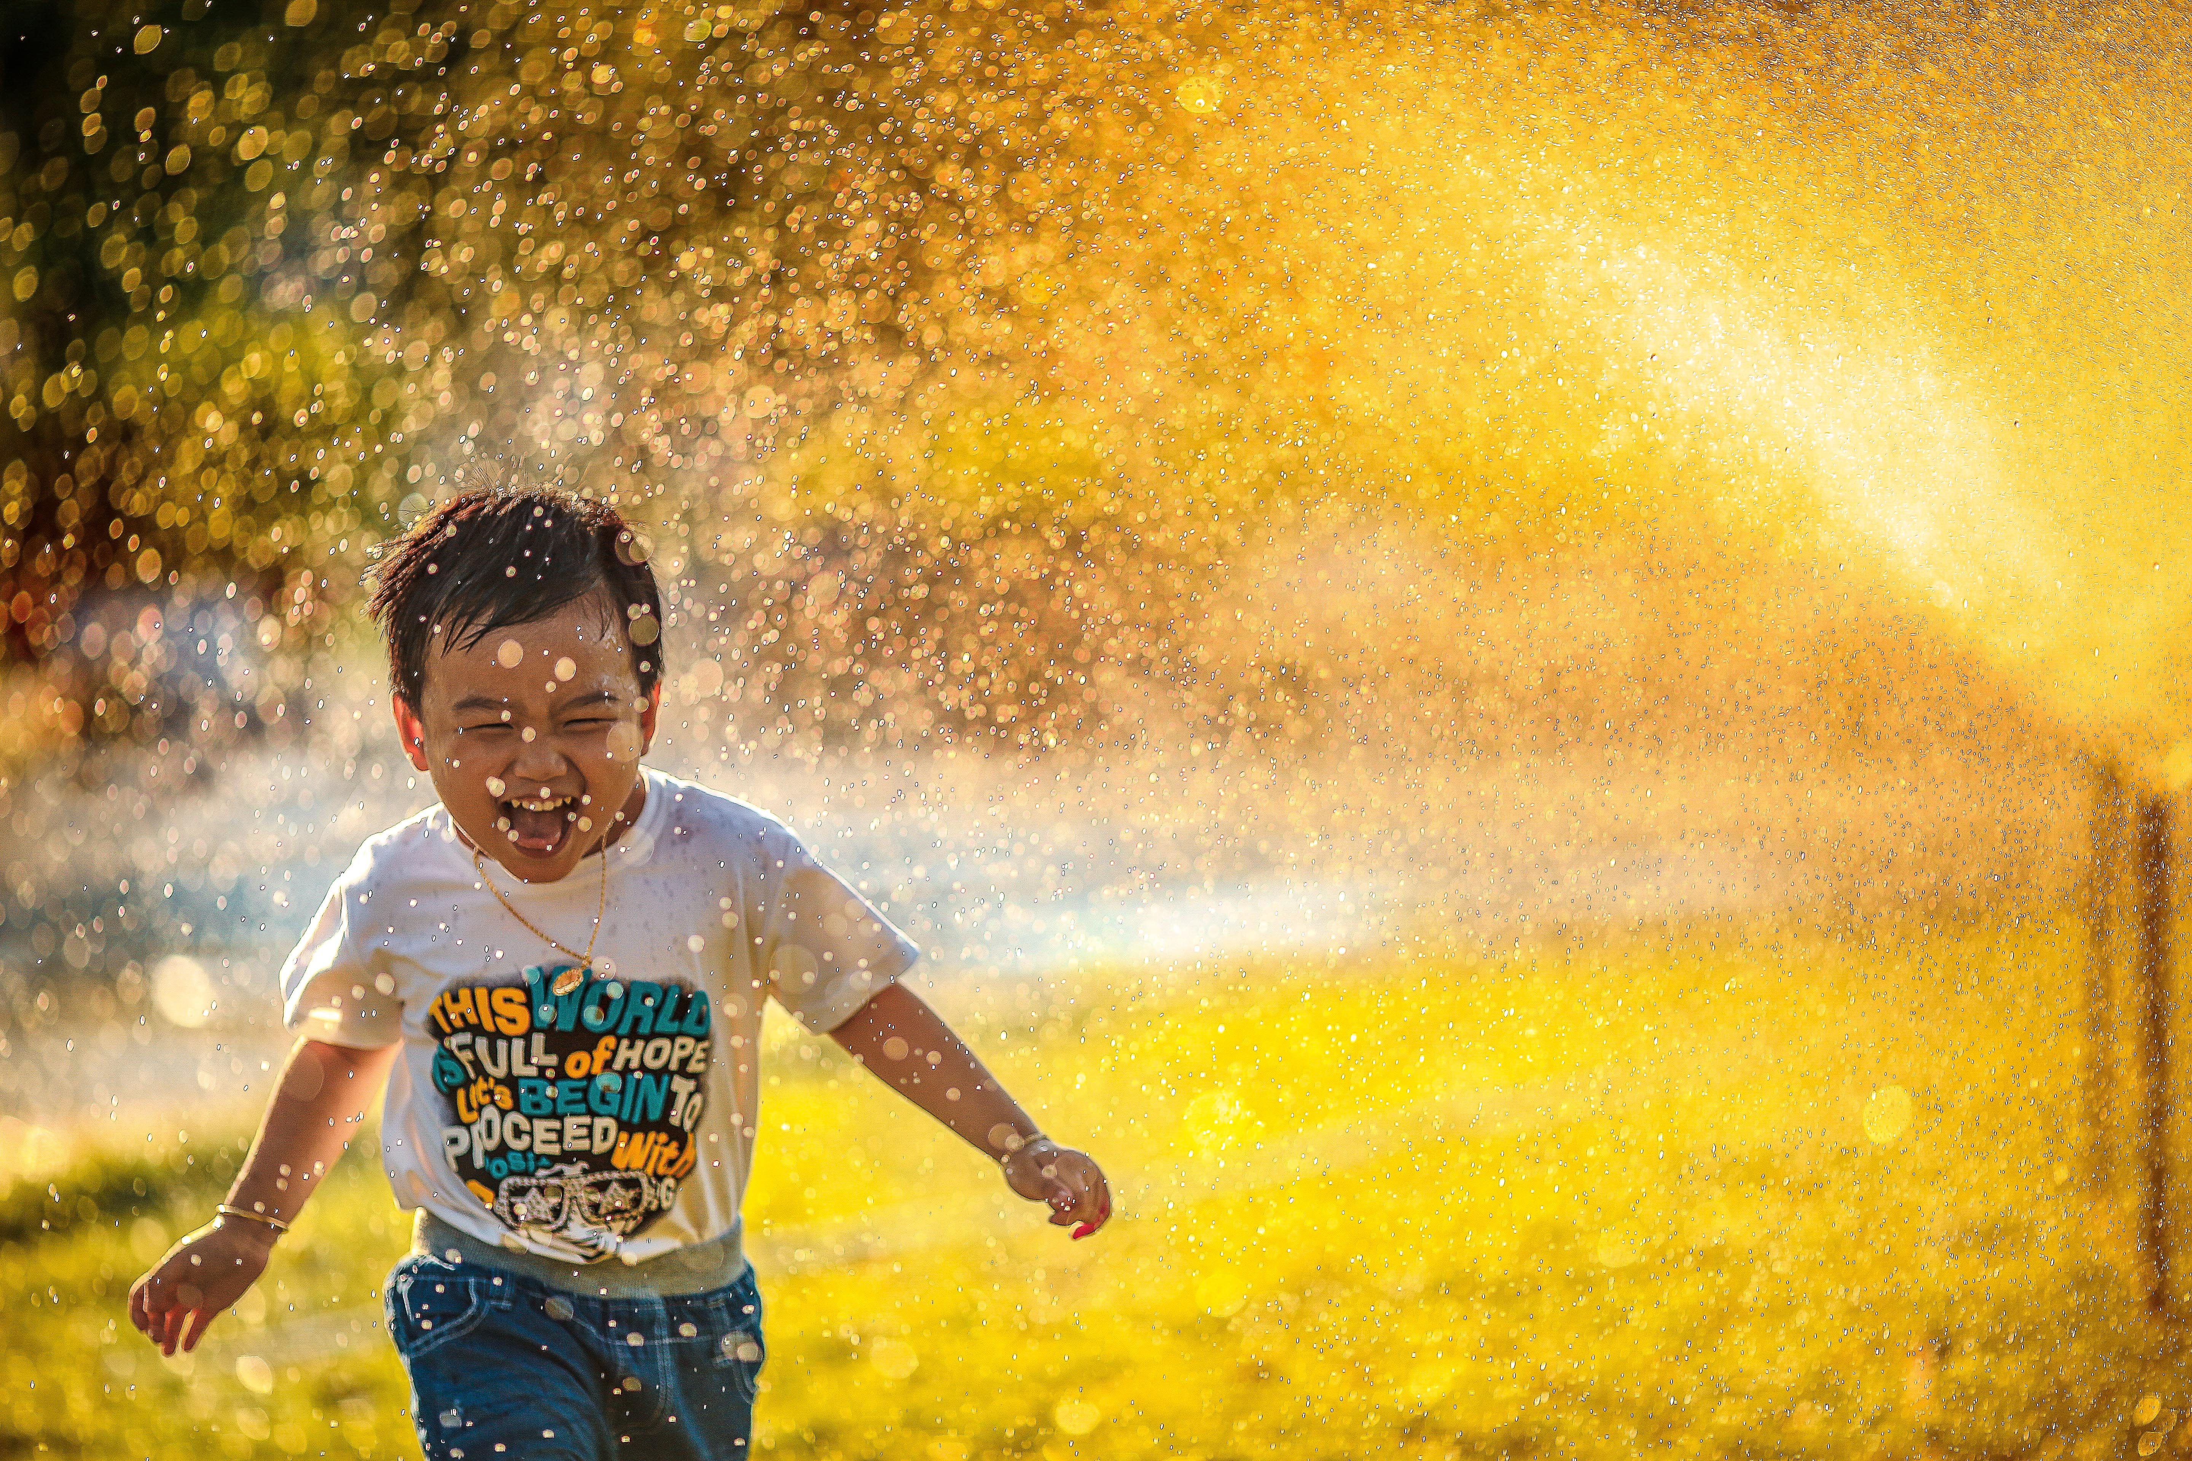
Whatumanawa – Emotions & heart
Me te wai kōrari
Like the nectar of the flax flower
Joy in small things.
Chat response:
What are the small things that brought you
and bring you joy? What goals would you set
yourself around bringing joy?
Reflection on responses

Slide 8
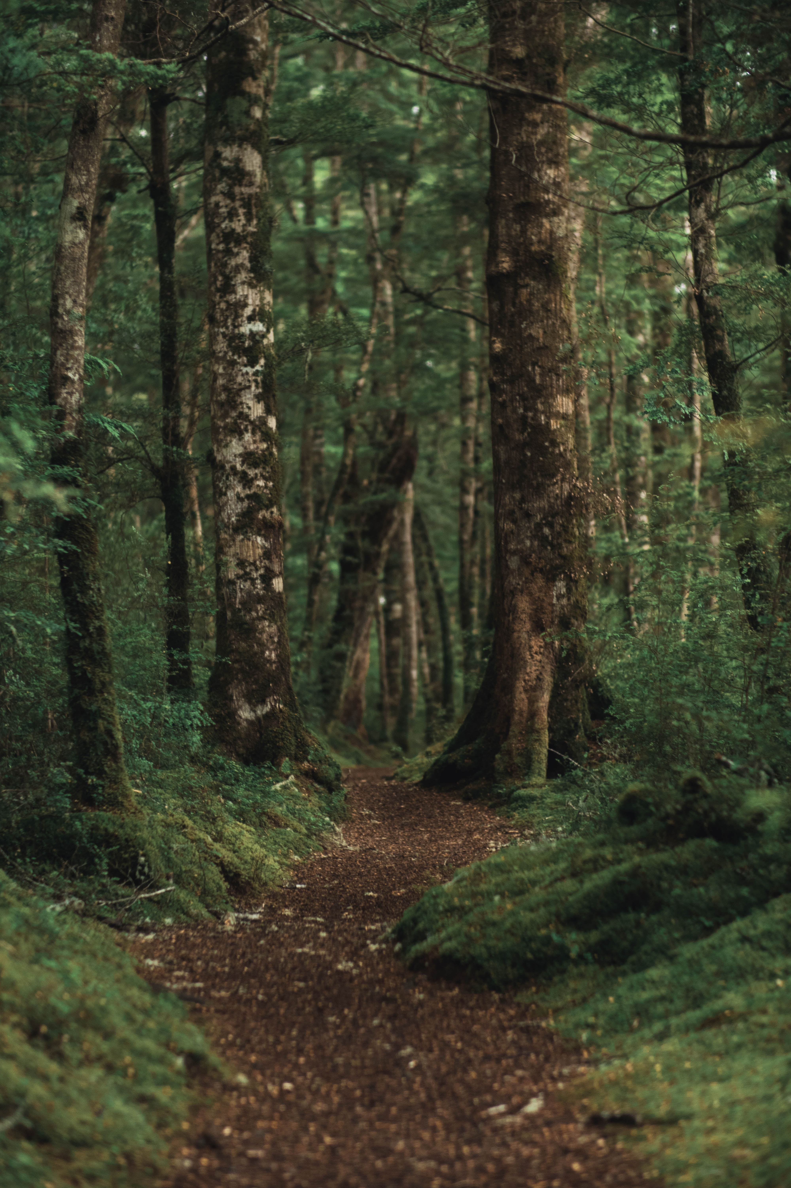
Waiora – Health & soundness
Me te toroa e tau ana i runga i te au.
Like the albatross nestled upon the current.
Manfiesting resilience with the elegance of nature.
Innovation & our creative energy.
Breakout room question:
With the many ‘currents’ we experienced what was it that brought you health, soundness?
What would you leave behind and what would you like to do more of?

Slide 9
Aio – Calm, peace, tranquility
E kore au e ngaro, he kākano ahau
i ruia mai i Rangiātea.
I can never be lost; I am a seed
sown from Rangiātea.
I have a reason for being
Balance, springing of energy.
Chat response:
When challenged with disruptions to you, whether that be within your workspace or whanau, what do you do to find some peace, to remain calm and tranquil?

Slide 10
Hinengaro – Consciousness, awareness
E hara taku toa i te toa takitahi, he toa takitini.
My strength is not as an individual, but as a collective.
Breakout room question
It has been easy for us to sometimes get in our heads and have moments of feeling alone. What do you need to remind yourself that you are not alone? Or to reframe loneliness to solitude?

Slide 11
Mauri – Vital essence
E kitea ai ngā taonga o te moana, me mākū koe.
If you see the treasure of the ocean, you'd better get wet.
Life is for living.
Chat response:
Where is this place for you?

Slide 12
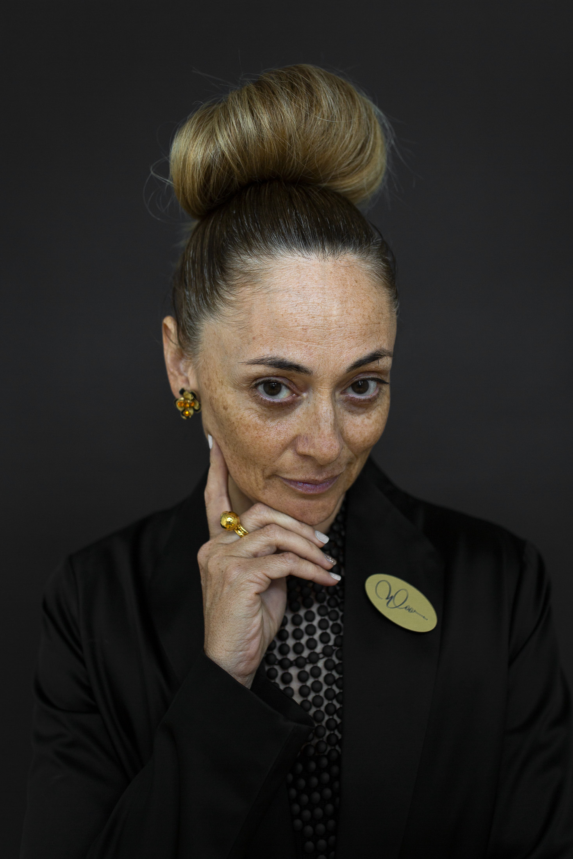
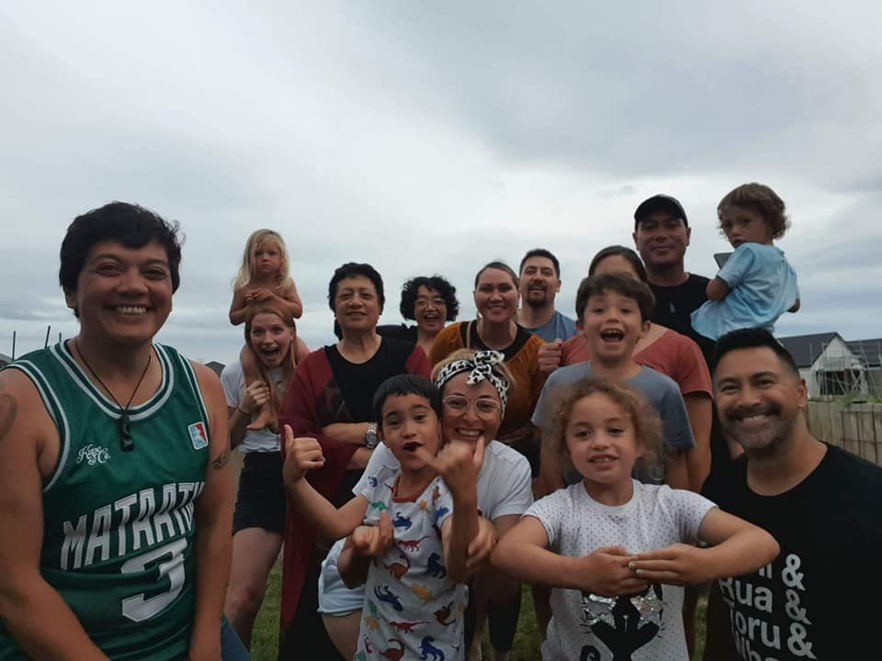
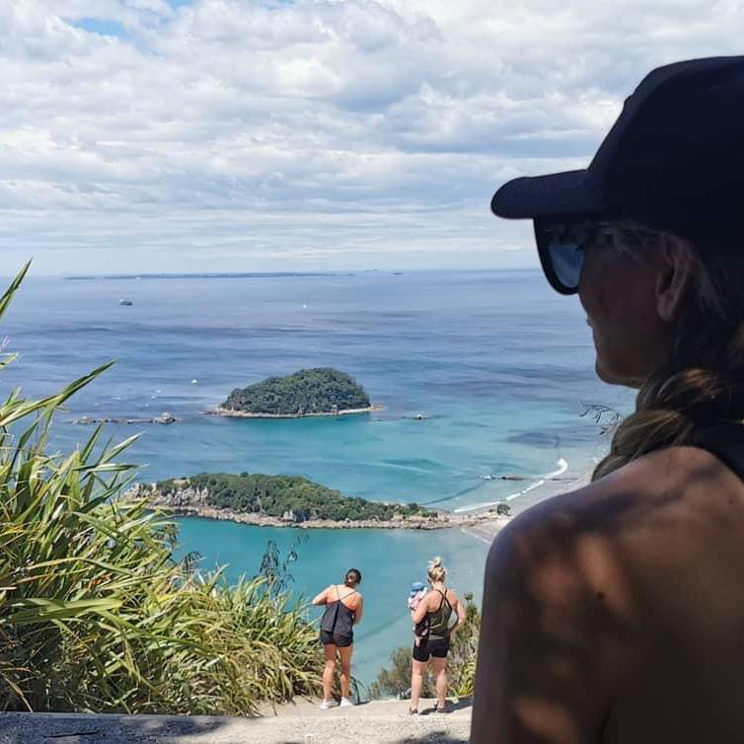
Own what you have within
Mahi
Whānau
Self

Slide 13
He pātai

Slide 14
Karakia whakamutunga
Kia tau, kia tātou katoa
Te atawahi o te tatou Ariki o Ihu Karaiti
Me te Aroha o te Atua
Me te whiwhinga tahitanga
Ki te wairua tapu
Ake ake ake
Amine

