Slide 1
Marketing & Communications
Creating content that counts in a changing world

Slide 2
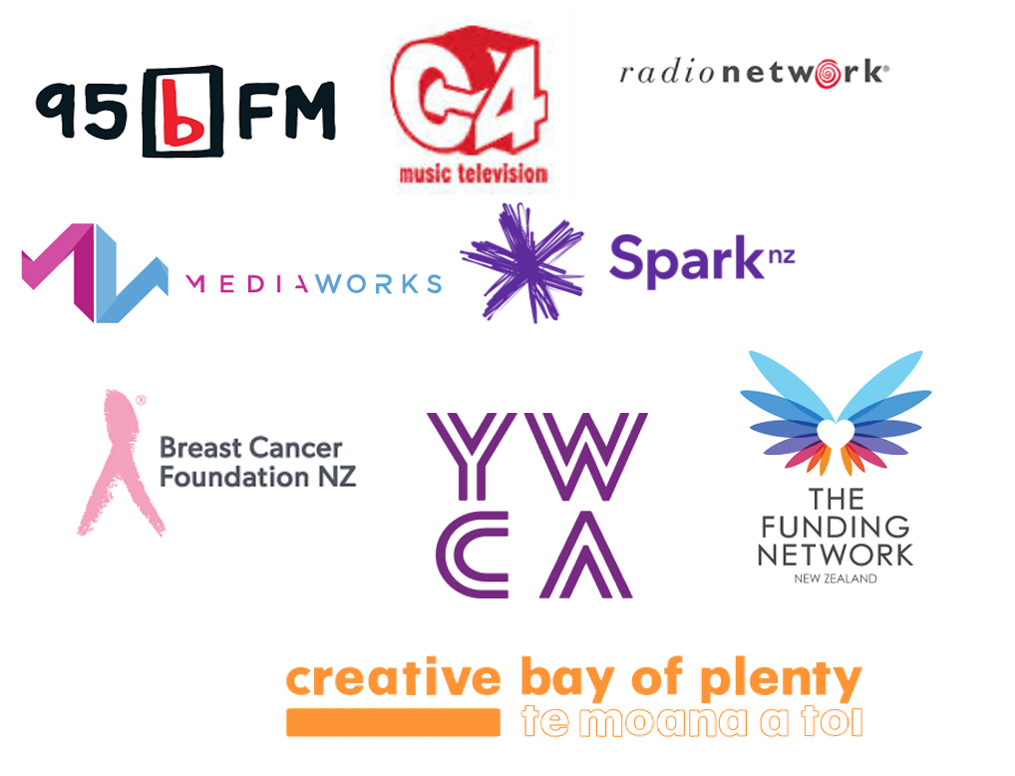
About me

Slide 3
Agenda
Identifying your supporters – creating personas
Crafting your case for support
Storytelling
Digital Marketing
Website
Content marketing basics
Social media
Email
Befriending the media
Questions?

Slide 4
Knowing your supporters
Community
those you serve or represent.
Community
local or central Govt agencies
delivery partners.
Support Partners
sponsors – cash or in kind.
Fundraising
grant makers and individuals.

Slide 5
Personas
A small group of people with faces, names and clear backgrounds, goals and challenges is much easier to understand and speak to than a vague list of data points.
The benefit of knowing exactly who you’re talking to through your marketing is huge.
This approach will help you maximise limited financial and human resources and improve your marketing ROI.
National Strategy for Community Governance examples.

Slide 6
Personas: How to
Target Audience Persona Development
BACKGROUND Where does your persona work? Does he/she have a college degree? From where? Is your persona married? Does he/she have kids? | DEMOGRAPHICS How old is your persona? What’s his/her household income? Does your audience skew male or female? Where does he/she live? Is it useful to call out ethnicity?
IDENTIFIERS What are your personas interests? What kind of supporter is he/she? How did your persona get involved? How are you currently communicating with him/her? | GOALS What does your persona want from you? Can you name any common goals outside of your organization?
CHALLENGES What roadblocks does your persona have to achieving his/her goals? What other challenges might he/she have? | HOW YOUR NONPROFIT HELPS How do you help this persona specifically? How can you help this persona achieve his/her goals? What can you do to surpass any challenges?
COMMON OBJECTIONS What objections might this person have to acting on your call to action or supporting your organization? | ELEVATOR PITCH How would you persuade this persona? What will your marketing message be”
A target audience persona outlines a typical member of a target audience.
They are fictional representations rooted in behavioural data and knowledge that you’ve gained from getting to know your supporters on a personal level.
You’ll use the data from your whole target audience to create a persona, but you’ll have one specific person to represent what you know about each of your main audiences.
Sprinting for Good persona template

Slide 7
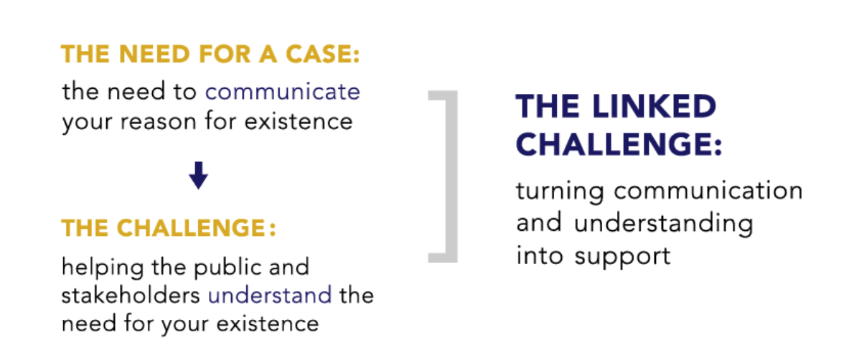
Your case for support
What is it?
Your key message for supporters.
An emotionally-compelling document that casts a vision for your organisation and tells donors why they should invest in your work.
Structure
Who are you and what do you do?
Why do you exist?
What is distinctive about you?
What need are you meeting?
How will donor support enable it to be met?
How can the donor become involved?
What's in it for them-i.e., why should they support you?

Slide 8
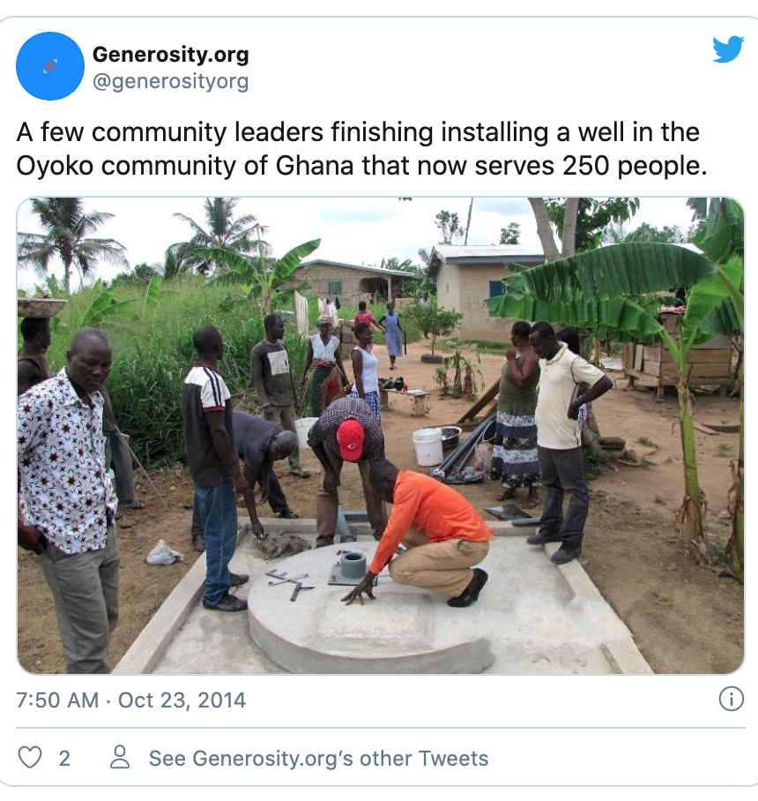
Story telling
The process of combining facts and narrative to communicate a message and an emotion to a target audience.
Closing the knowledge gap between supporters and your organisation.

Slide 9
Five key steps to story telling
Define the goal and key message.
Know your audience (personas).
Hero and Villain (character and conflict).
Collecting stories.
Sharing stories.

Slide 10
Digital marketing

Slide 12
Digital marketing

Slide 13
Your website
website useability assessments
$
Convert
Engage visitors. Build Community
Raise awareness
Fundamentals
design around specific goals, or actions
always tell your story simply and clearly
make your “calls to action” obvious and position up front
refresh continually to improve usability.

Slide 14
Content marketing
SEO & SEM
key words critical for search ranking
crucial for website re-design
Google ad grants.
Free for NFPs
Google apps
YouTube Non-Profits.

Slide 15
Social media best practices
Set up accounts as non-profits
Add donations
Use free training and resources
Develop guidelines & policies
Create a content calendar
Post shareable content
follow the news cycle
run a hashtag campaign
signal boost with tags and partners
host an online event.

Slide 16
Platform audiences

Slide 17
Platform audiences

Slide 18
Strategy & measurement
Engagement
Reach
Traffic to and from website
EDM Sign Ups
# repeats

Slide 19
Measure & review
Revisit your Strategy
Did we follow the plan?
Did we stay on budget?
Challenges of this strategy?
How did we overcome these obstacles?
Feedback from our target audience?
What should we have done differently?
Should we use this strategy as a model for future efforts?
Make a Social Media Measurement Spreadsheet
Google Analytics
Unique visitors
Visits
Most popular content
How people find you
Social media referrals
Don’t focus on “vanity metrics.”
Actions from posts show the real value

Slide 20
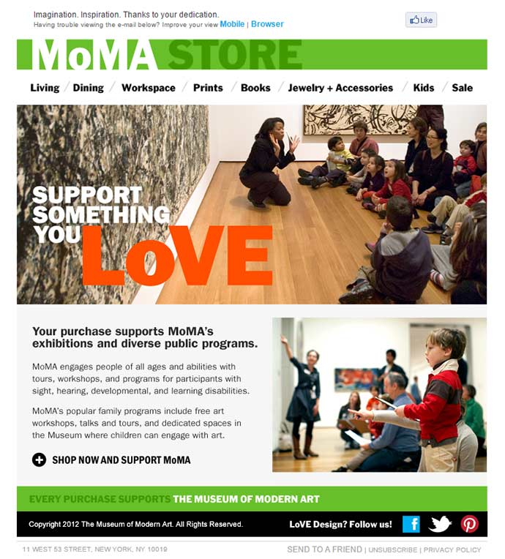
Email marketing
don’t spray and pray
have a plan…..content is KING!
spend time on design
drive web traffic and responses
test, test, test!
what time is now?
share to social.

Slide 21
The media

Slide 22
Getting the basics right
respond promptly
make it easy
know your case for support / key messages
great talent & strong images
pitch appropriately for the medium
remember: what and so what?
give to maintain the relationship.

Slide 23
What is news?
local angles on national stories
expert and informed comment
surveys and consumer trends
solutions to customer problems
new, first, last, unique, biggest etc
conflict and drama.*
* approach with caution!

Slide 24
Interviews: Top tips
Print & online
check deadlines
do your research
highlight numbers & surveys
create photo opportunities
present interesting and relevant information
reinforce your main points with real examples.
Radio
keep it brief with soundbites
be interesting!
use words to create a picture
watch your pace
avoid mobile phones.
TV
don’t look at the camera
be concise
use strong language
give examples.
Nothing is “off the record”!

Slide 25
Free resources & templates
media release
media contact list
pitching guide
other great stuff!
https://communitycomms.org.nz/resources/media-relations/

Slide 26
Takeaways
There is money out there for charities, NFPs and trusts especially post COVID 19. This can fund marketing capacity & capability building.
Existing platforms like Givealittle can work harder with better stories and a specific ask.
‘Fish your feet first’. Your community can be optimised as friend-raisers, story tellers and donors.
There is great free help available online.

Slide 27
Questions?

