Slide 1
Our House of Wellbeing
Te Whare o Hauora

Slide 2
Karakia tīmatanga
Hauora mai runga
Hauora mai raro
Hauora mai roto
Hauora mai waho
Hauora te pūtake o tēnei kaupapa
Kia pūrangiaho mātou, i te wānanga me te kōrero
Tenei te titi ake i te pou hauora ki te pūtake o tēnei wānanga
Tuturu o whiti whakamaua, kia tina, tina, haumie, hui e taiki e

Slide 3
Ko āu
Notes:
The Kia Whiti Tonu programme has been developed following the recently released national COVID-19 impact survey of tangata whenua, community and voluntary organisations.
Carried out over May and June 2020 by CSI in partnership with Hui E! Community Aotearoa, Philanthropy New Zealand, and Volunteering New Zealand, the findings of the survey were published in the Time To Shine report.
The survey identified a strong commitment across the sector to respond, recover, and then reshape for the future. It also identified some key areas where respondents wanted support to help them shine brightly and build back better after the disruption of COVID-19.
Talk to Health and Safety, feeling safe and comfortable
Session is being recorded to enable to share this with others
However, breakout spaces are not recorded

Slide 4
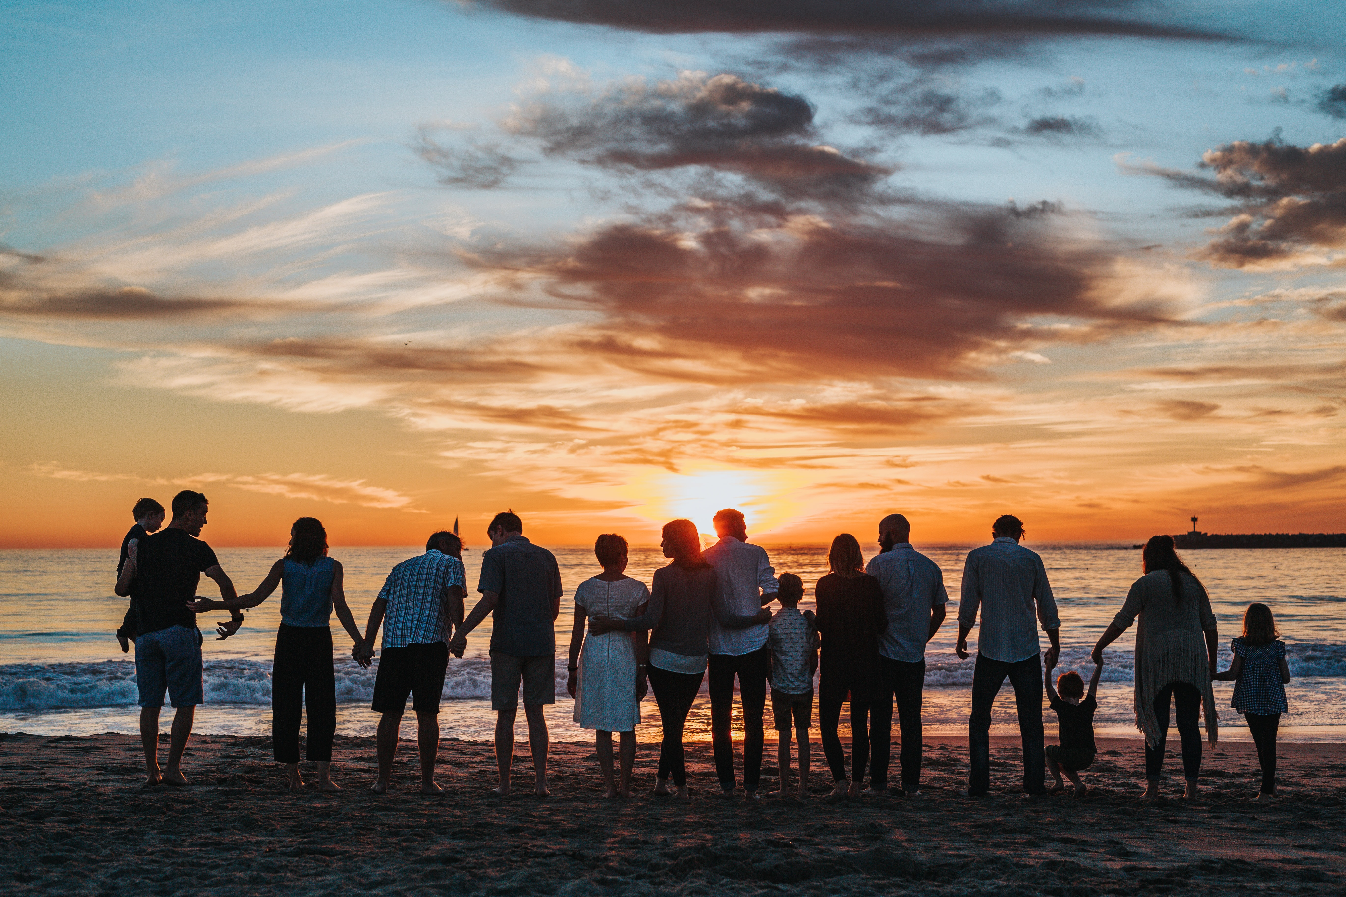
Nau mai
What brought you here?
Whakawhānauatanga.
(post answer in chat)

Slide 5
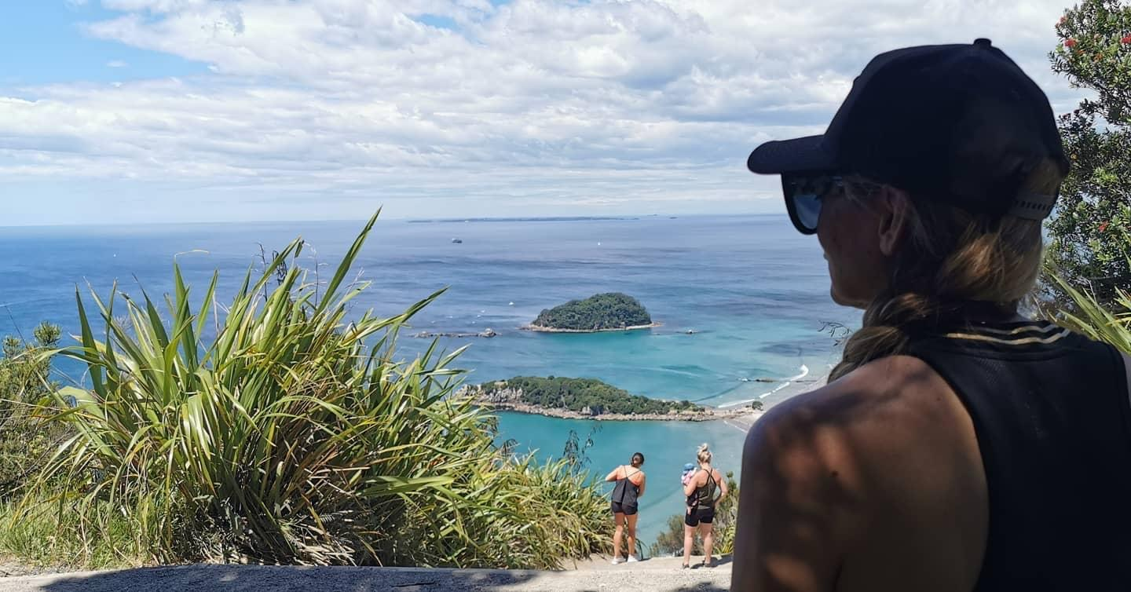
Our whare of hauora
Reminding ourselves
reflection
honest conversations with self

Slide 6
Taha tinana
Our tinana is our house.
Understanding the importance of caring for our tinana.
Understanding the importance of ‘using’ our tinana.
Breakout room question:
What do you do for your tinana?

Slide 7
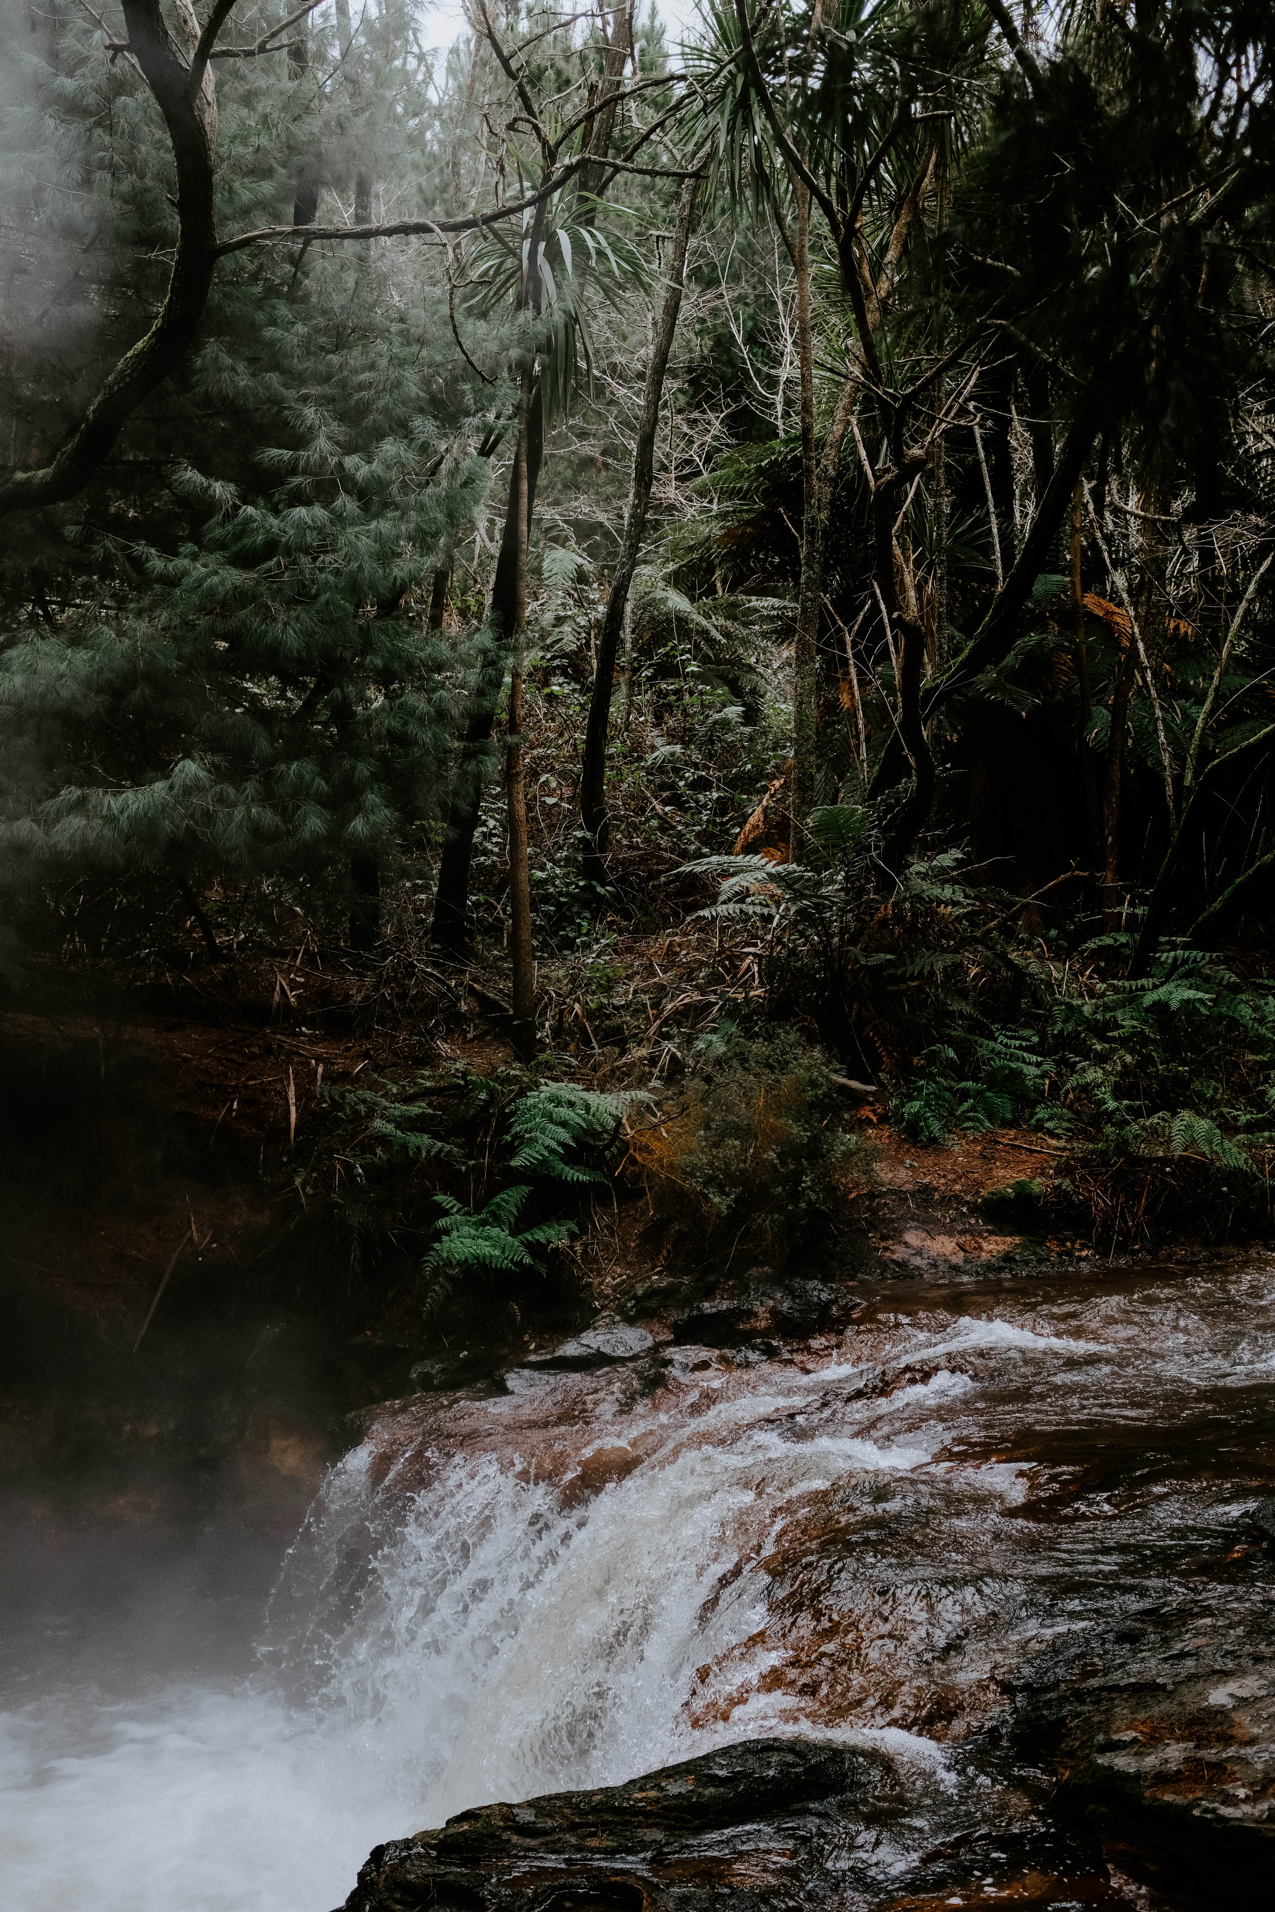
Taha wairua
Looks like and feels like different things to different people.
Often intangible, it cannot be seen.
What is the space or place for you?
Breakout room question:
Where do you go? What space and/or place? What does it feel like and look like to you e.g. church, karakia, environment?
Notes:
Morning karakia
Music (vibration)

Slide 8
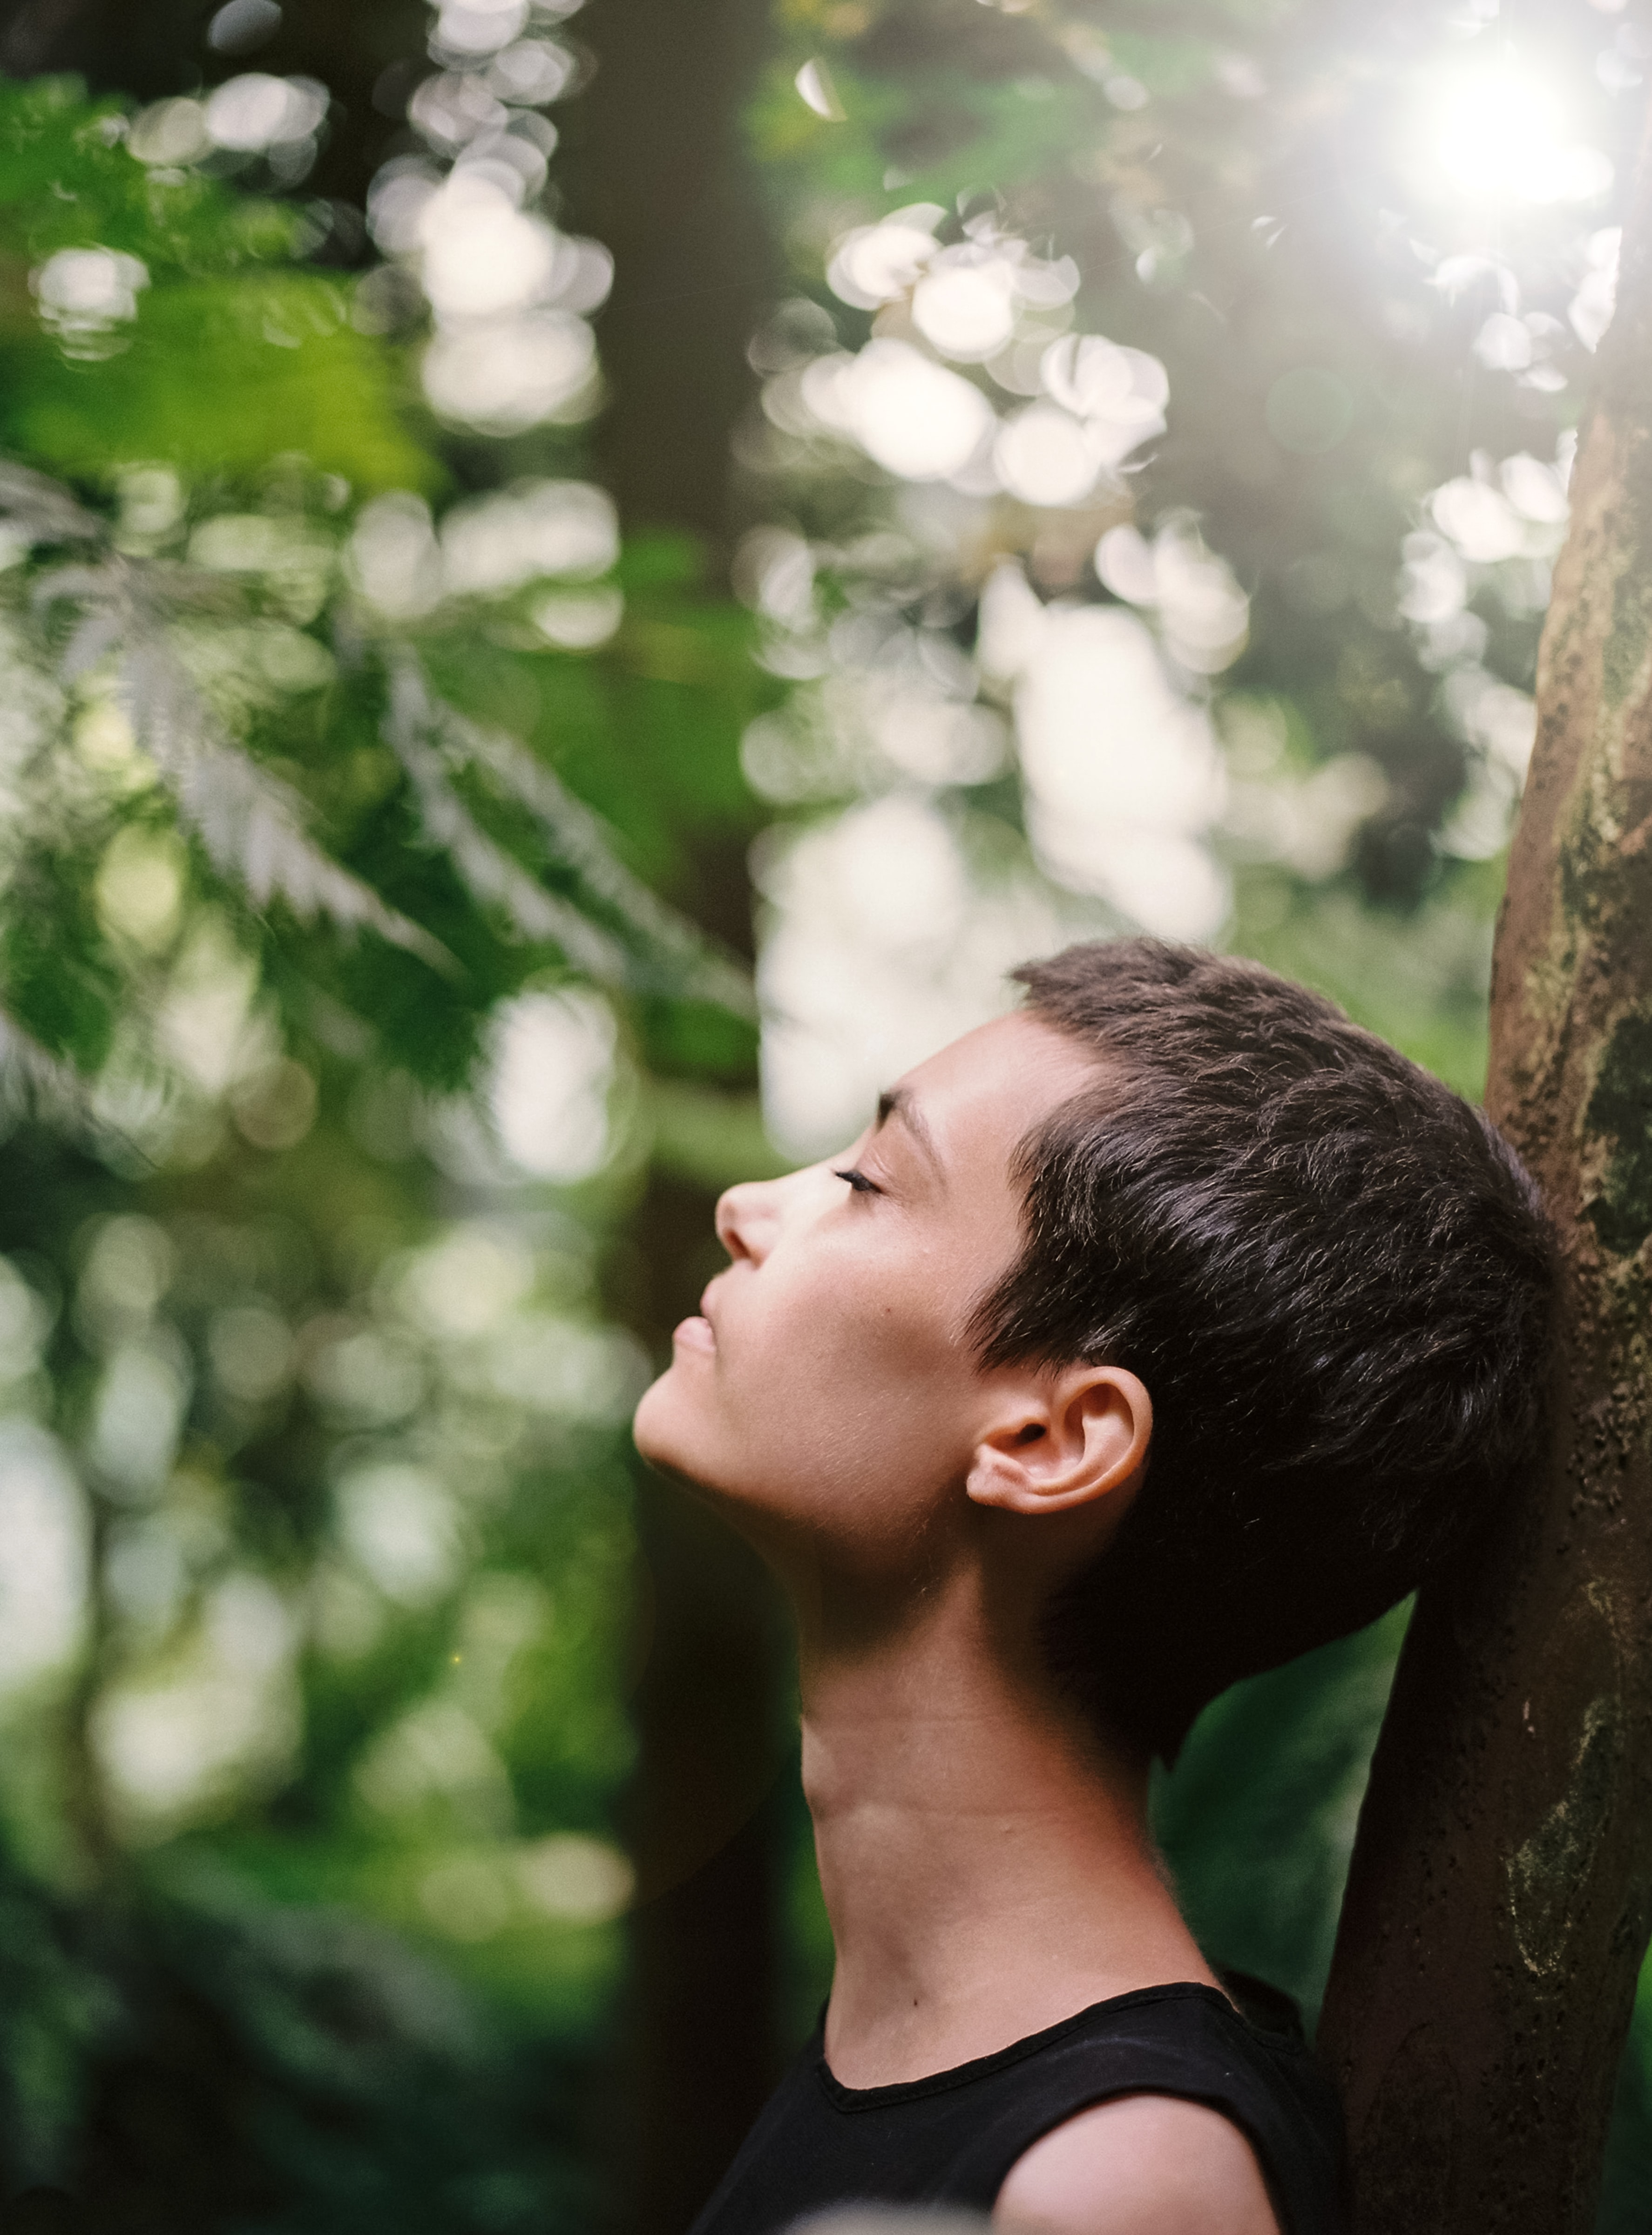
Taha hinengaro
Powerful
challenging year, challenging times
acceptance.
Breakout room question:
What have you done or you do for your hinengaro? How do you take some time e.g. reflection and/or gratitude, read a book
Notes:
Be kind
Conversations with friends & whanau
Validating the voices and conversation in our heads

Slide 9
Taha whānau
Belonging, care & share your life with
connection
sense of belonging.
Breakout room question
Who is whanau? What connects you to them?

Slide 10
Whenua
Connection to the environment
space/place
improved wellbeing.
Breakout room question
It’s well noted that being within the environment can improve your wellbeing. How do you connect to the environment, your turangawaewae, what is your turangawaewae? Your place of belonging, ‘home’.

Slide 11
Application
Mahi
whānau
self.

Slide 12
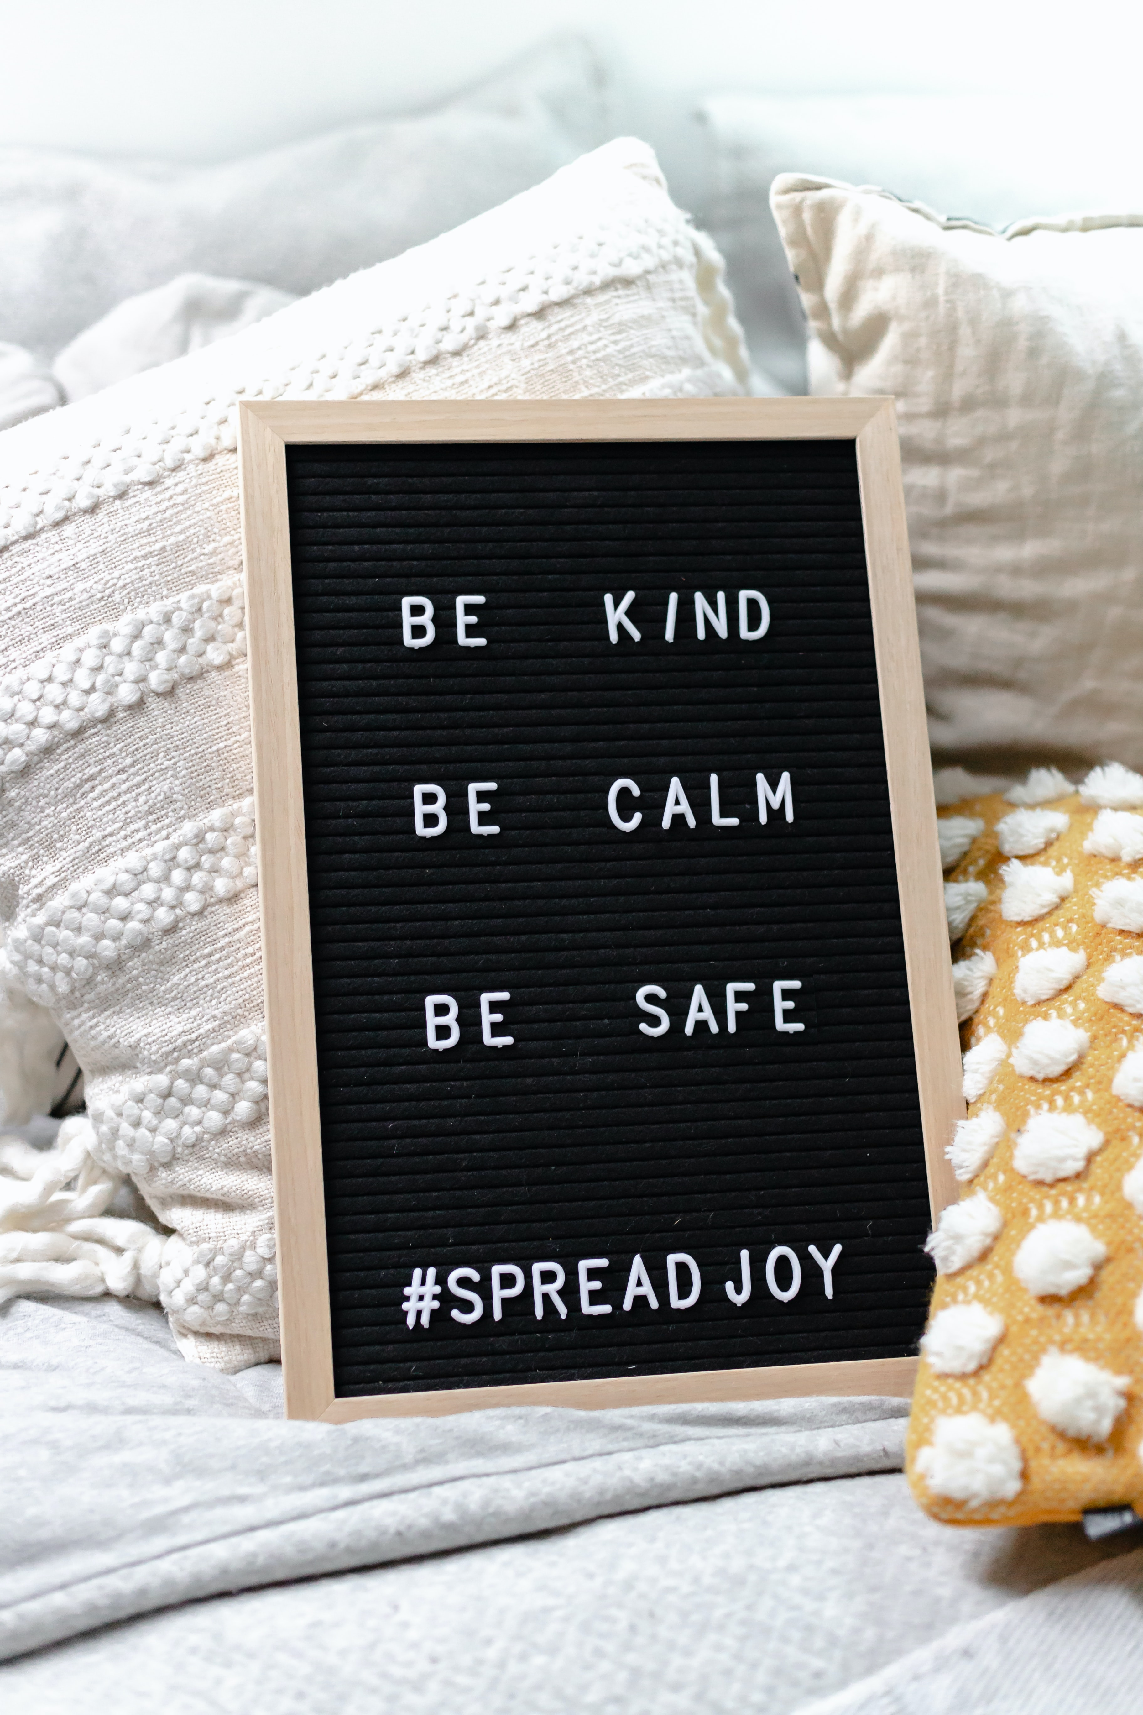
Feel the burn (Burnout)
Visit, return, visual, utilise your senses.
Be kind to yourself.
Utilise your Whare of Hauora.
Refer to your Te Whare Tapa Wha.

Slide 13
He pātai

Slide 14
Resources
https://mentalhealth.org.nz/helplines
https://mentalhealth.org.nz/search?query=Te+Whare+Tapa+Wha
https://www.healthnavigator.org.nz/
quotes, podcasts, YouTube
text/call 1737

Slide 15
Karakia whakamutunga
Kia tau, kia tātou katoa
Te atawahi o te tatou Ariki o Ihu Karaiti
Me te Aroha o te Atua
Me te whiwhinga tahitanga
Ki te wairua tapu
Ake ake ake
amine

