Slide 1
Radical Collaboration - a mastery art
Kia Whiti Tonu
To Shine Brightly
July 2021

Slide 2
Radical collaboration is vital in these times. We don’t need only more single hero's leading movements, we need collectives that can form the connective tissue between them that operate as fields of intelligence to land new inspiration and pathways of evolution. We have only called it radical because it seems radical for our time to work in this way, however it is actually natural and one day will be our new normal.

Slide 3
Reflection and our exploration today
What state do you need to be in to truly collaborate?
How do you connect to that state as a team and as individuals?
When have collaborations worked well for you? What are the key ingredients? When didn’t they work? What were those ingredients?
How do we do it better?
How do we clear the barriers that keep us stuck?
How do we be brave and experiment!

Slide 4
Our nervous system

Slide 5
To collaborate deeply means we have a deep sense of self, so we can accept others and work from our essential place to theirs. Our magic to there's.

Slide 6
Principles and process
Purpose - the collaboration purpose is clear and in service of what the system is asking for and needing.
Connection - we take the time to set up the container and the connective tissue between us and keep it healthy.
Everyone has a place - that aligns with strengths and purpose, not just with role.
Honoring multiplicity - we honor the collaboration and the organisation they come from – you cant take hats off.
Aroha atu - Aroha mai - what we are asking and giving to each other has some balance over time.
We honor what came first - from the treaty to the original impulse for the collaboration.
Restoration - we restore as we go, we model the system changing as well as changing the system.
Clearings - We clear the space between us to not build elephants.
Resourcing - we resource for the journey – individually and collectively.
Emerging and experimenting - we understand there are multiple pathways and we prototype to continually evolve and learn.

Slide 7
The way we approach the problem is the problem
 | Current way | Radical collaboration
How we approach the challenge | Agree on what the problem is. Agree on the evidence. Create project teams that reflect evidential base. | Agree on a larger systemic approach. Agree to stand in a holistic worldview to approach the challenges. Feel the future we want to land in us. Help everyone find their dream in the collective dream.

Slide 8
The way we create teams
Current way | Radical collaboration
Who has the power to influence Who are technically the best Who might represent the system Role based only | Select people who have the ability to collaborate and work with themselves as part of a collaboration. Select people who can honour their organisation and the collaboration – living bridges. People who can cross and influence worlds. Bring in technical expertise as needed. Spend the time sewing the threads of connection deep enough to hold the mahi.

Slide 9
How we envisage the future
Current way | Radical collaboration
Based on past evidence Single policies Fixed legislation Look at what others are doing Solution building Making others do things Isolating the problem from broader context. | Creating spaces where inspiration can land in the present Setting off experimental evolutionary pathways that can keep learning and adapting. Understanding there are multiple emergent possibilities always. Modelling how we can all do things Creating enabling conditions

Slide 10
What cultures do we need to grow?
Current way | Radical collaboration
Often tacit involvement from some Solution building Waiting for consensus to move forward or steamrolling Often the expected people are at the table. High performing teams Dedication to the outcome Not interested in personal, collective or cultural growth Often the cognitive mind the leader of solutions Focus is on adding value to one part of the system, eg social or environmental rather than both Hierarchical | Cultures that can actively work with conflict, and whatever is arising including resistance Cultures robust enough to stay in relationship Realise we are the system and always work with us as part of the whole We work with being the system changing not only changing the system Taking one step forward even if we disagree. Creating unlikely alliances Deep performing teams Dedication to the process as outcome and to the development and growth of all involved Works with all intelligences of the body and system Value is added to all systems as you go Natural hierarchy

Slide 11
Shifts
Need for control ---------------------------- High ability to share power
Need for certainty ------------------------- Ambiguity ability high - can work with chaos without tidying
Single recognition ------------------------ Shared success
Silos and territory ------------------------- High autonomy and cooperation
Failure a problem -------------------------- Failure a learning
Fixed mindset ------------------------------- Open mind, heart and ears
One way --------------------------------------- 1000 flowers bloom
Constrained and planned --------------- Playful, experimental, curious
Low self awareness ----------------------- Work is growth for our life
Perfect people ------------------------------ Everyone has a place
Work only on the task -------------------- Work on the container
The work is priority ------------------------ The relationships and quality of the container is the priority

Slide 12
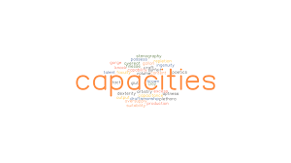
Capacities
Be able to come from different worldviews and paradigms.
Be able to see when stuck in separation paradigms/trauma highways.
Deep listening, listening in layers – presence.
Staying connected to self as sensing instrument – attunement.
Connected to mother earth – being able to ground – embodiment.
To be able to digest life – allowing life to land in you and process and learn.
Coherence builder in self and team.
Shadow work – able to see and work with your own projections.
Emergers and alchemists – can work with the emerging future not just the one planned.

Slide 13
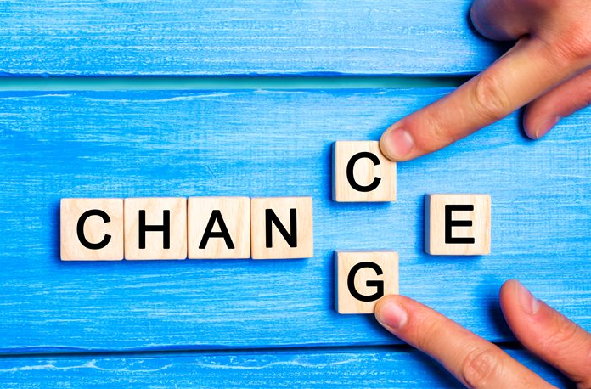
So why change?
Most of our issues are collaboration issues e.g. climate change.
Our times requires far deeper collaborations.
We need to transform our self and our relationships to transform the world.
“I can’t” – together “we can”.
Need deep performing teams that get beyond achievement to flow.

Slide 14
Traps – what gets in the way
Human ego and heroism
Trauma
Not creating the time for whanaungatanga
Doing what you have always done
Getting stuck in survival
Staying in paradigms that don’t serve us
Re-colonising instead of decolonising
Not nourishing the collective

Slide 15
Next steps for change
Collaborate better in-house first – create the space and process for what deeper collaboration would look like inside your organisation.
From there feel where there is the energy for a small, deeper collaboration to learn and grow from.
Invite others in who feel the same and are up for learning.
Use the strengths in your team to create the collaboration – not role but those who can truly help people connect.
Start from a shared dream you can feel is possible.
Create evolutionary pathways that can adjust.
Follow the principles and processes.

Slide 16
Process for starting or resetting
Bring all parties together for whakawhanaugatanga.
Set agreements that you all actually agree to.
Share understanding of what a health collaborative space needs to be nourishing for all.
Agree to the need for individual work on projections and clearings of tension.
Agree to working with tension as a creative potential.
Dream together of what is possible and how that needs to land in all of you for you to be the system changing as you change the system – restoring as you go.
Help each find their own dream in that, and their part of the system’s dream.
Prototype and experiment together to set off evolutionary pathways of learning and changing.

Slide 17
Resources
Theory U: https://www.ottoscharmer.com/theoryu
The penultimate resource for a different way of collaborating.
Donella Meadows http://donellameadows.org/archives/leverage-points-places-to-intervene-in-a-system/
https://reospartners.com/
Explore platforms: https://resources.workable.com/tutorial/collaboration-tools

Slide 18
More resources
Future search network: https://futuresearch.net/
Good combination of resources: https://collaborationforimpact.com/
https://www.twyfords.com.au/the-power-of-co/
https://www.beyondstickynotes.com/
Regenerative thinking: https://regenesisgroup.com/

